Slide 1
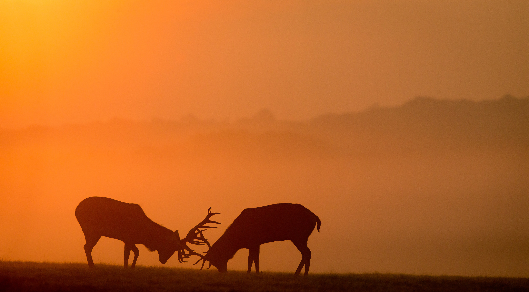

Irish Animals
The Herbivores

Slide 2
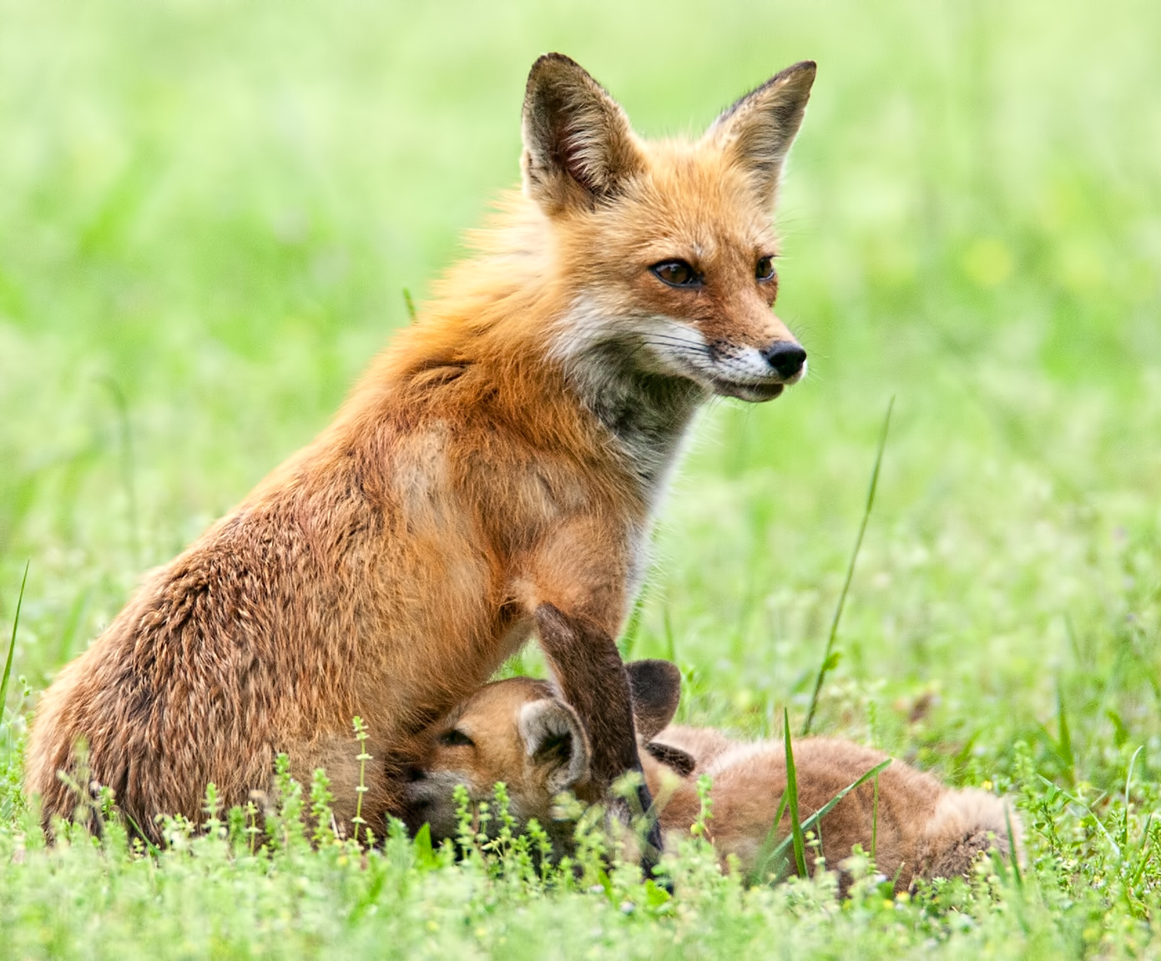
What is a Mammal?
All mammals breathe air through their mouth and nose.
All mammals have hair.
All mammals feed milk to their young.
All mammals have a spine and a skeleton.
Almost all mammals give birth to live young.
Are you a mammal?

Slide 3
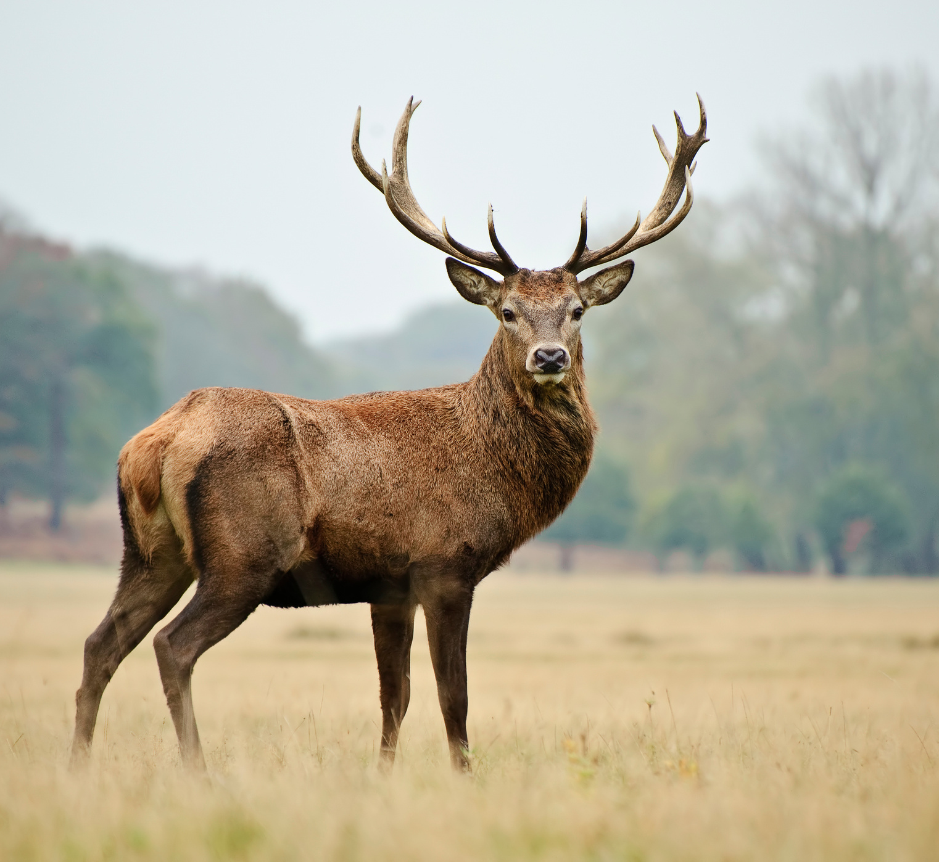

Red Deer
Fia Rua
Cervus elephas
Red Deer are our largest land animal.
They are our only Native species of deer.

Slide 4
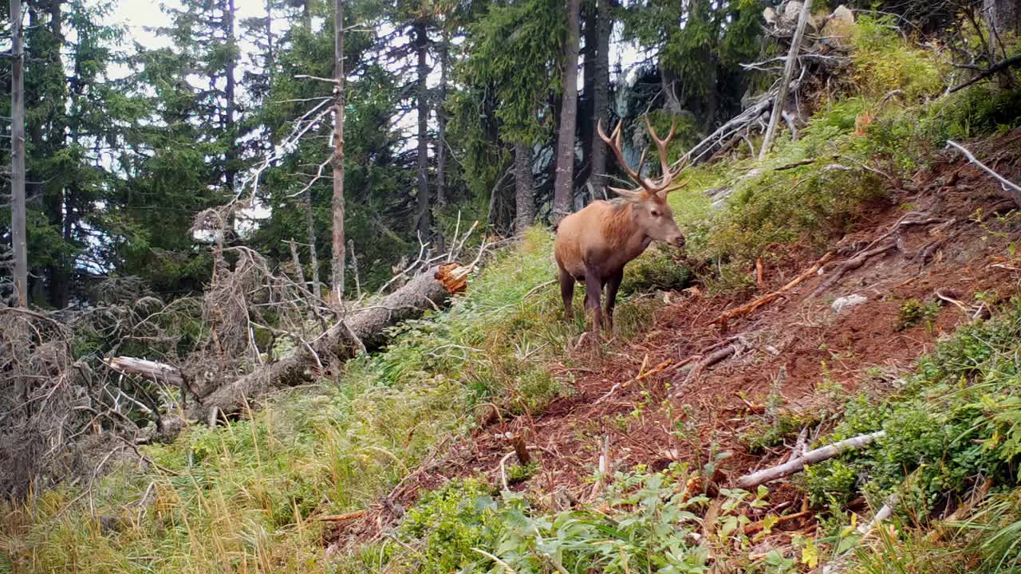
Red Deer stag

Slide 5
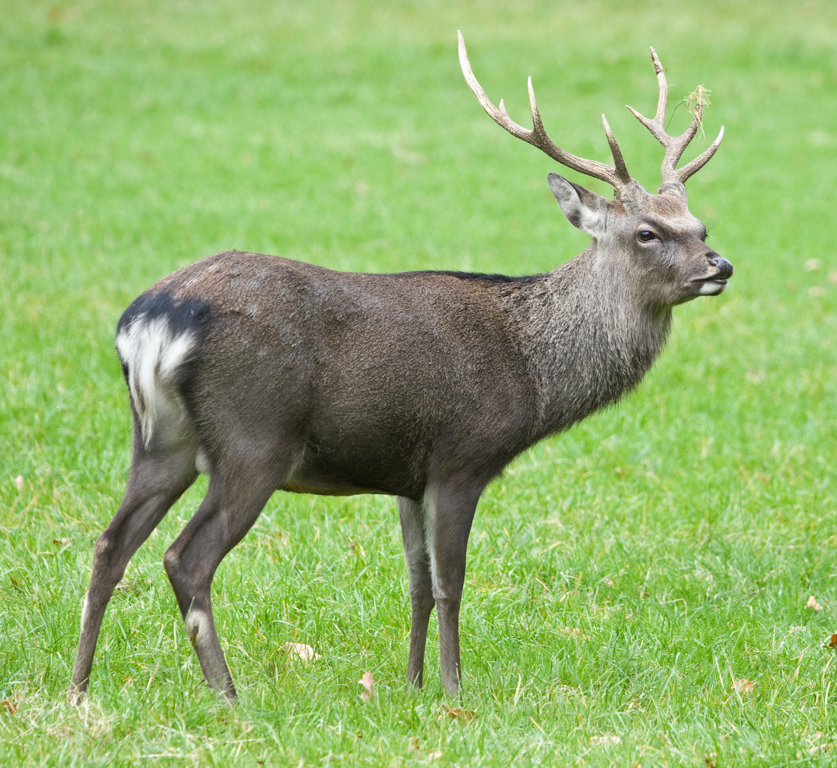
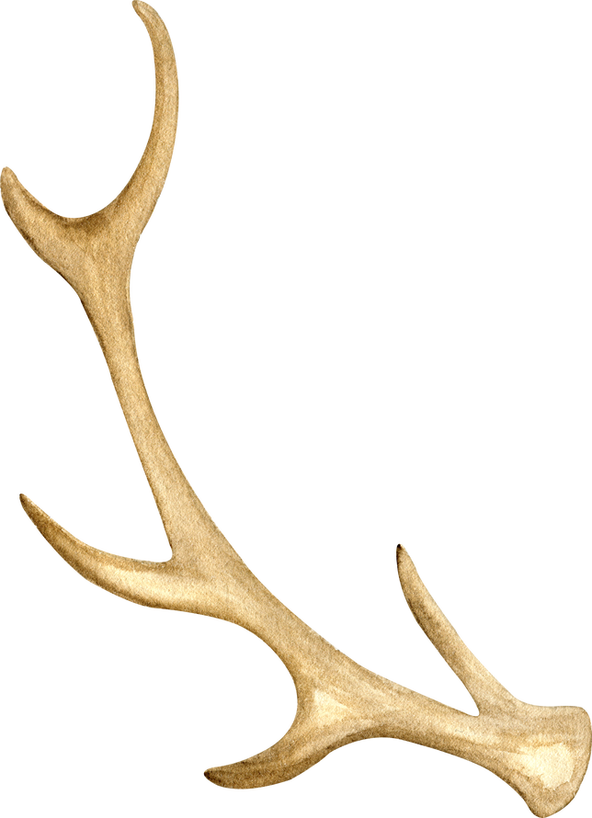
Sika Deer
Fia Seapánach
Cervus nippon
Sika deer were introduced to Ireland a hundred years ago.
They came from Asia.

Slide 6
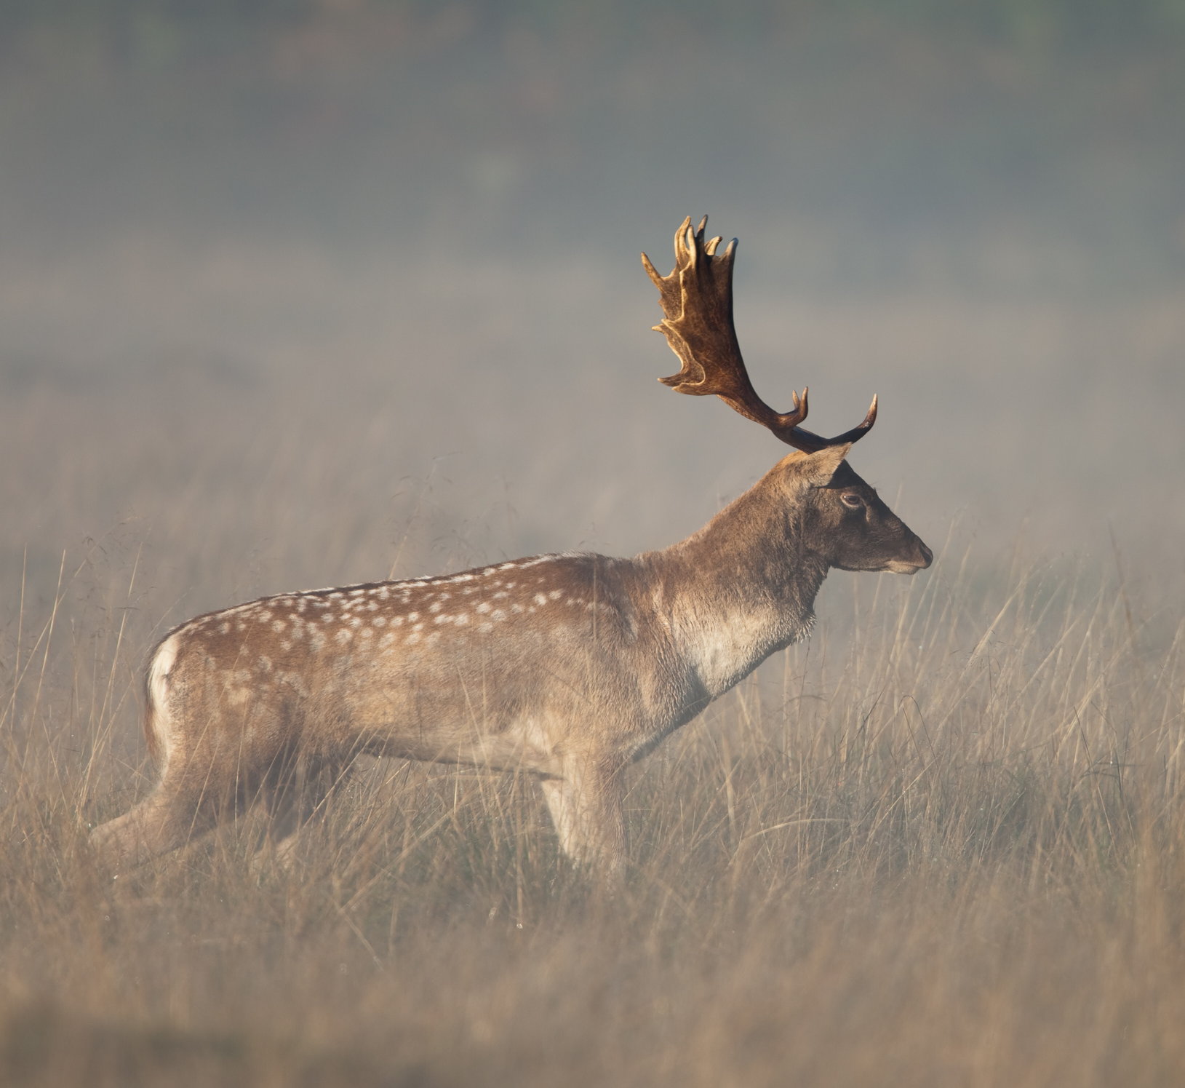
Stoat
Fia Buí
Dama dama
Fallow Deer were introduced to Ireland by the Normans.
The stags have wide flattened antlers.
They come in several colours.

Slide 7
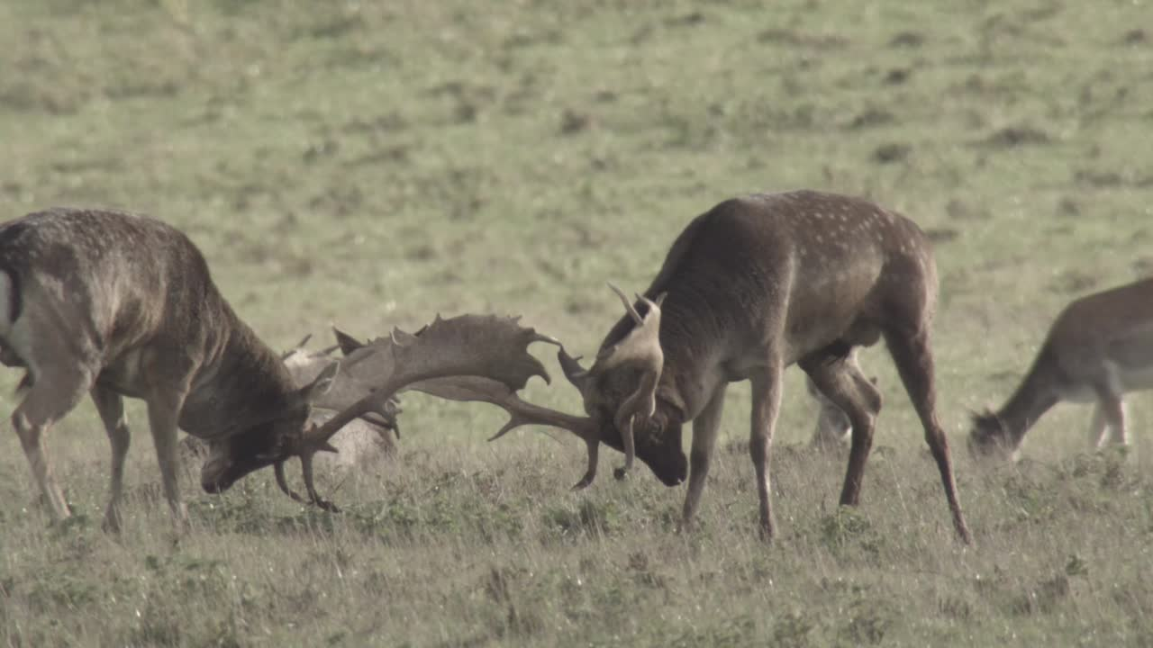
Fallow Deer

Slide 8
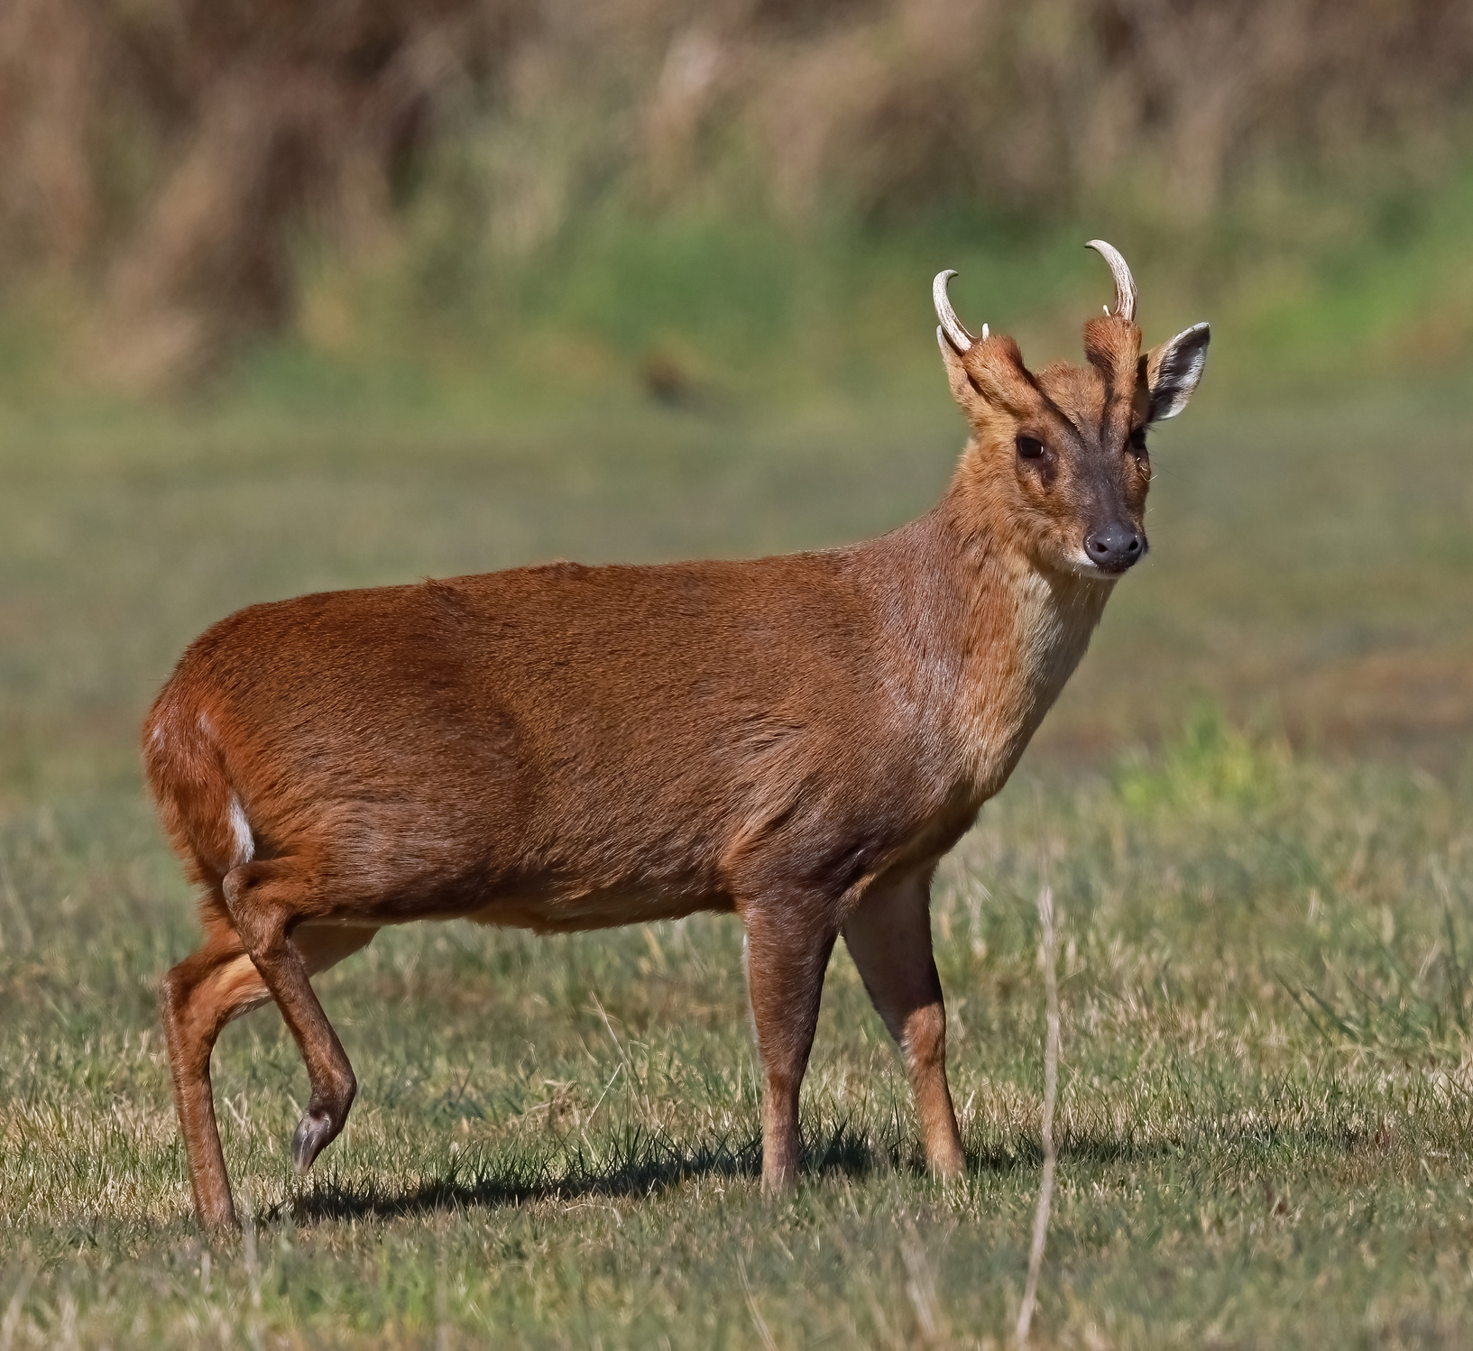

Muntjac
Muinseac
Muntiacus reevesi
We may also have muntjac in Ireland. It is believed that they have recently been illegally released, possibly by hunters.
They are an invasive species because they cause damage to habitats.

Slide 9
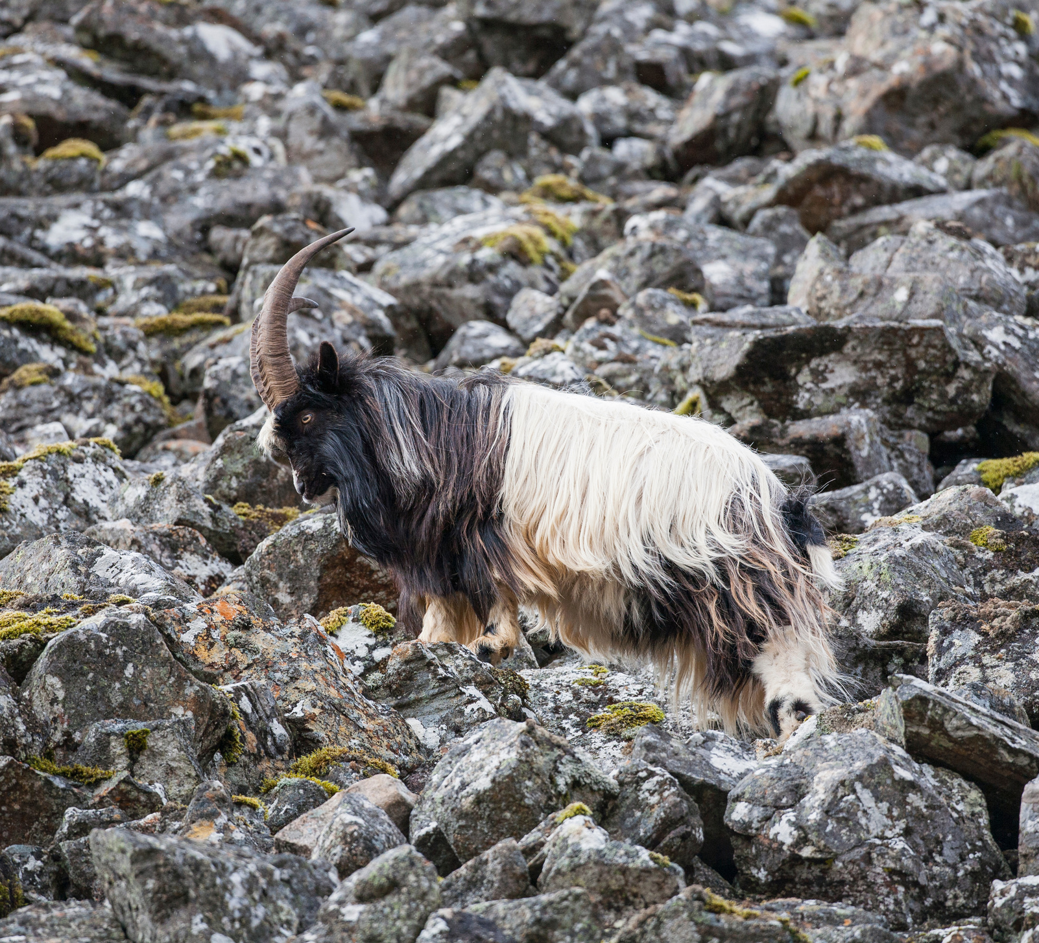

Wild Goat
Gabhar Fia
Capra hircus
Irish wild goats were originally tame animals. They escaped and went wild over hundreds of years.
Both males and females have horns.

Slide 10
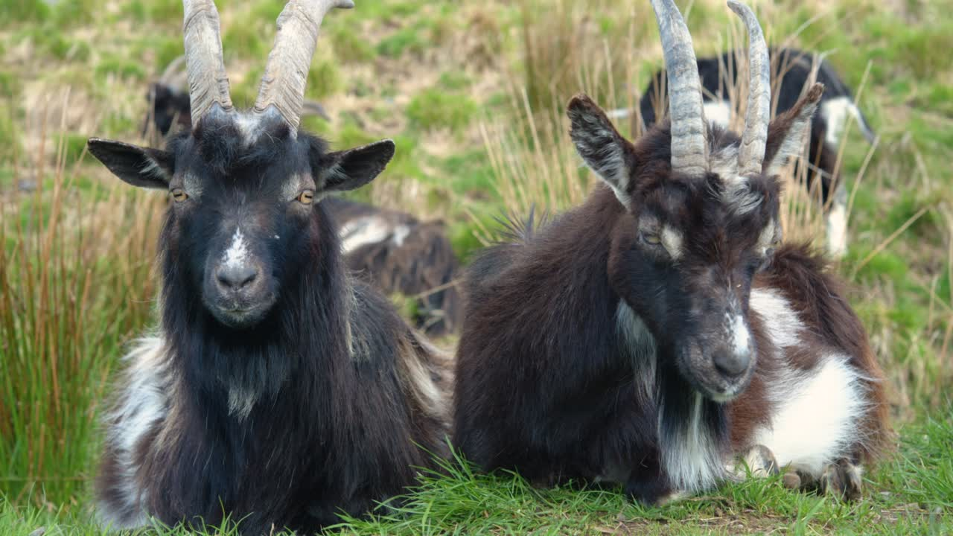
Wild goats

Slide 11
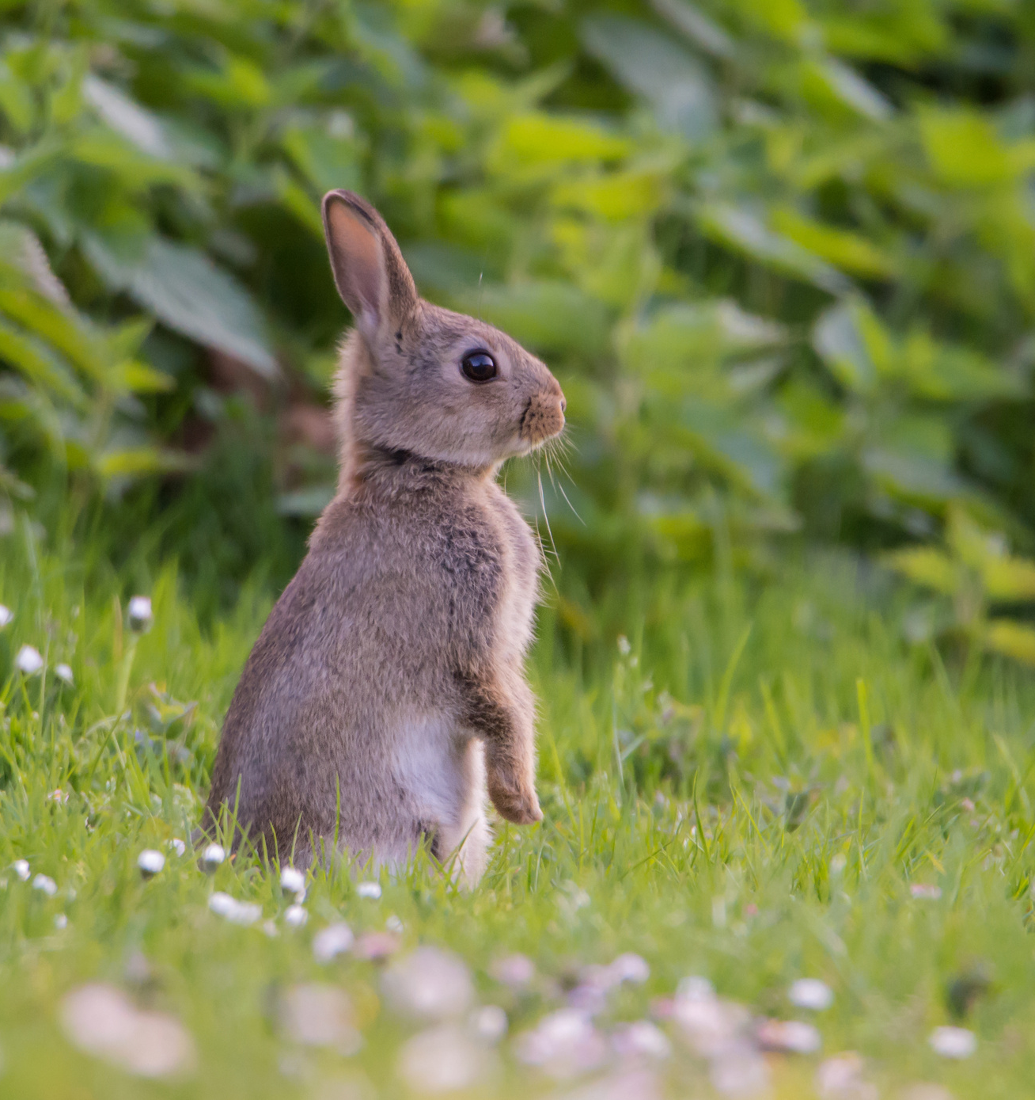
Rabbit
Coinín
Oryctolagus cuniculus
Wild rabbits are another species that were bought to Ireland by the Normans for food.
Rabbits breed quickly and are an important food for many other species, such as foxes and buzzards.

Slide 12
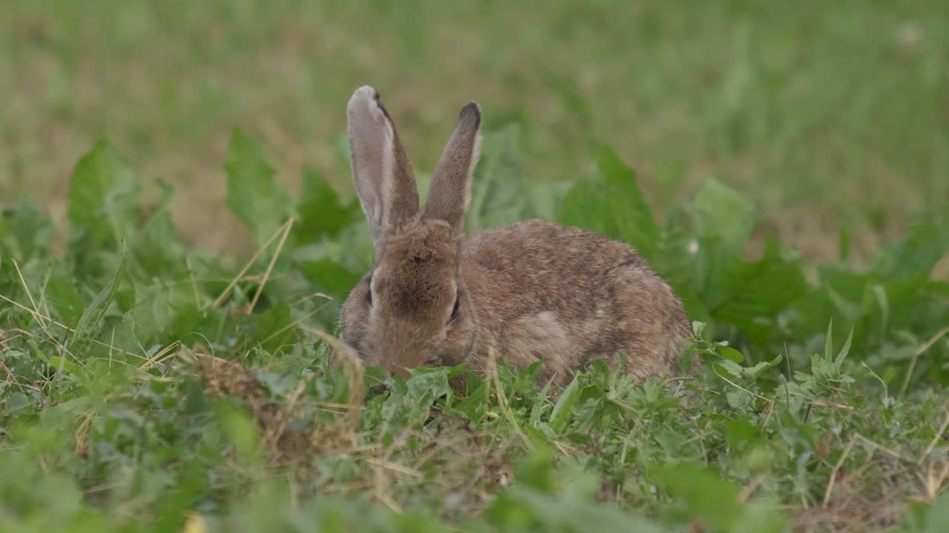
Wild rabbit

Slide 13
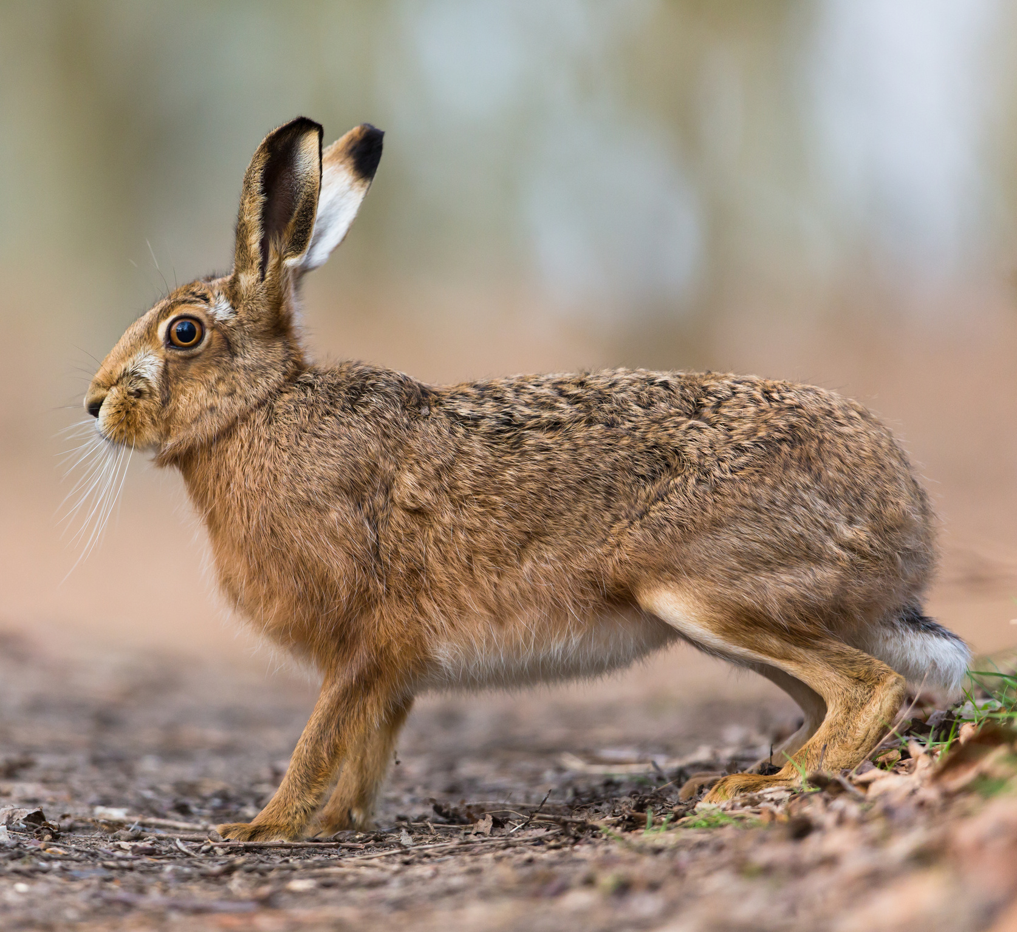
Irish Hare
Giorria
Lepus timidus hibernicus
Ireland has its own special hare. It is smaller than the English hare. It rarely turns white in winter, unlike its Scottish cousins.

Slide 14
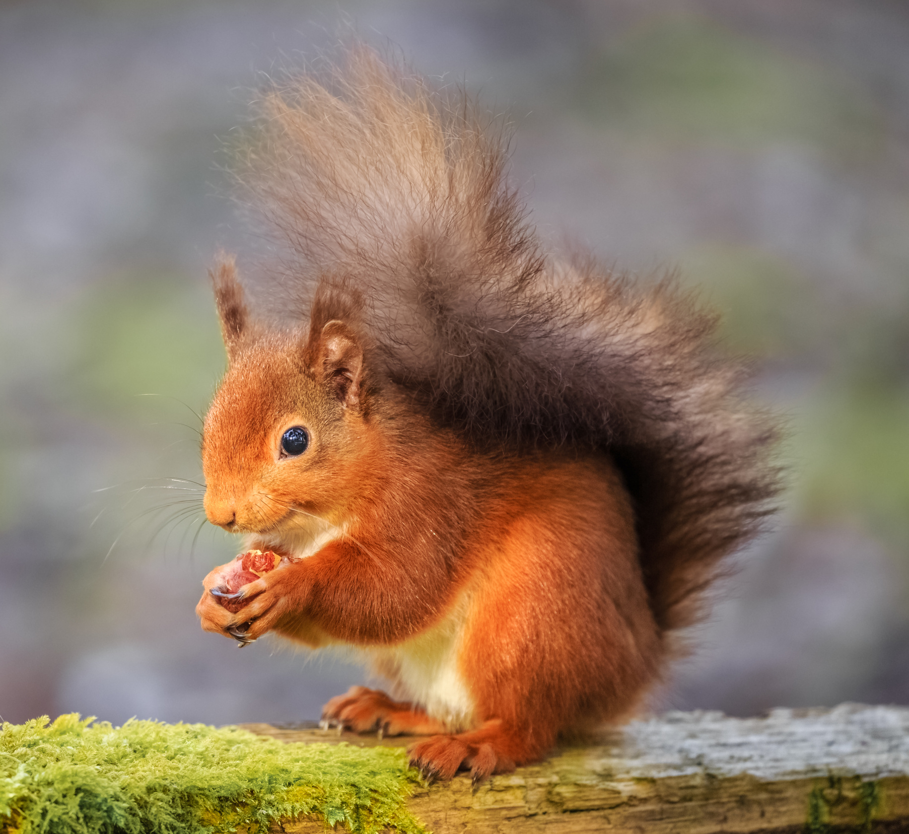
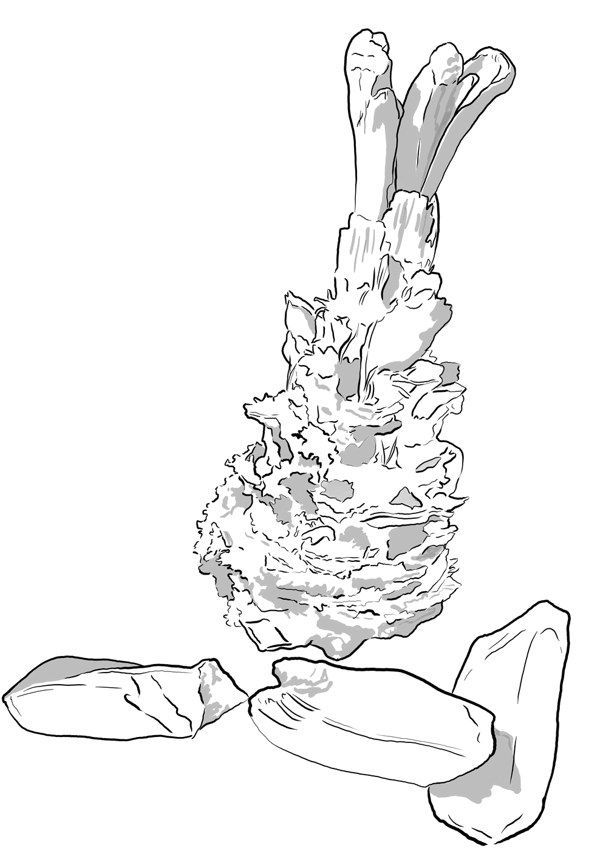
Red Squirrel
Iora Rua
Sciurus vulgaris
The Red Squirrel is a native animal. It lives in trees and eats nuts and seeds. In some areas it has become scarce due to competition with introduced Grey Squirrels.

Slide 15
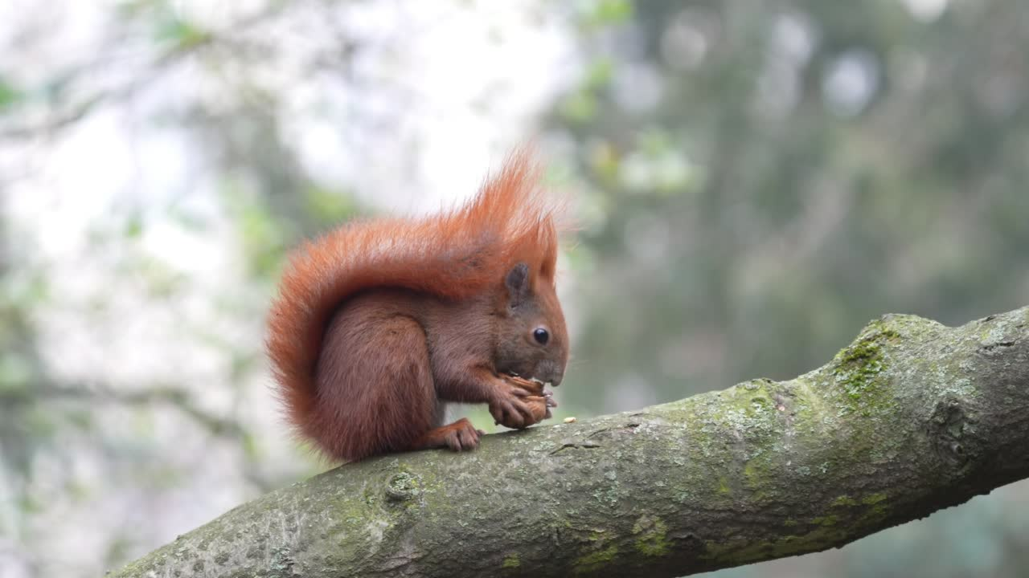
Red Squirrel

Slide 16
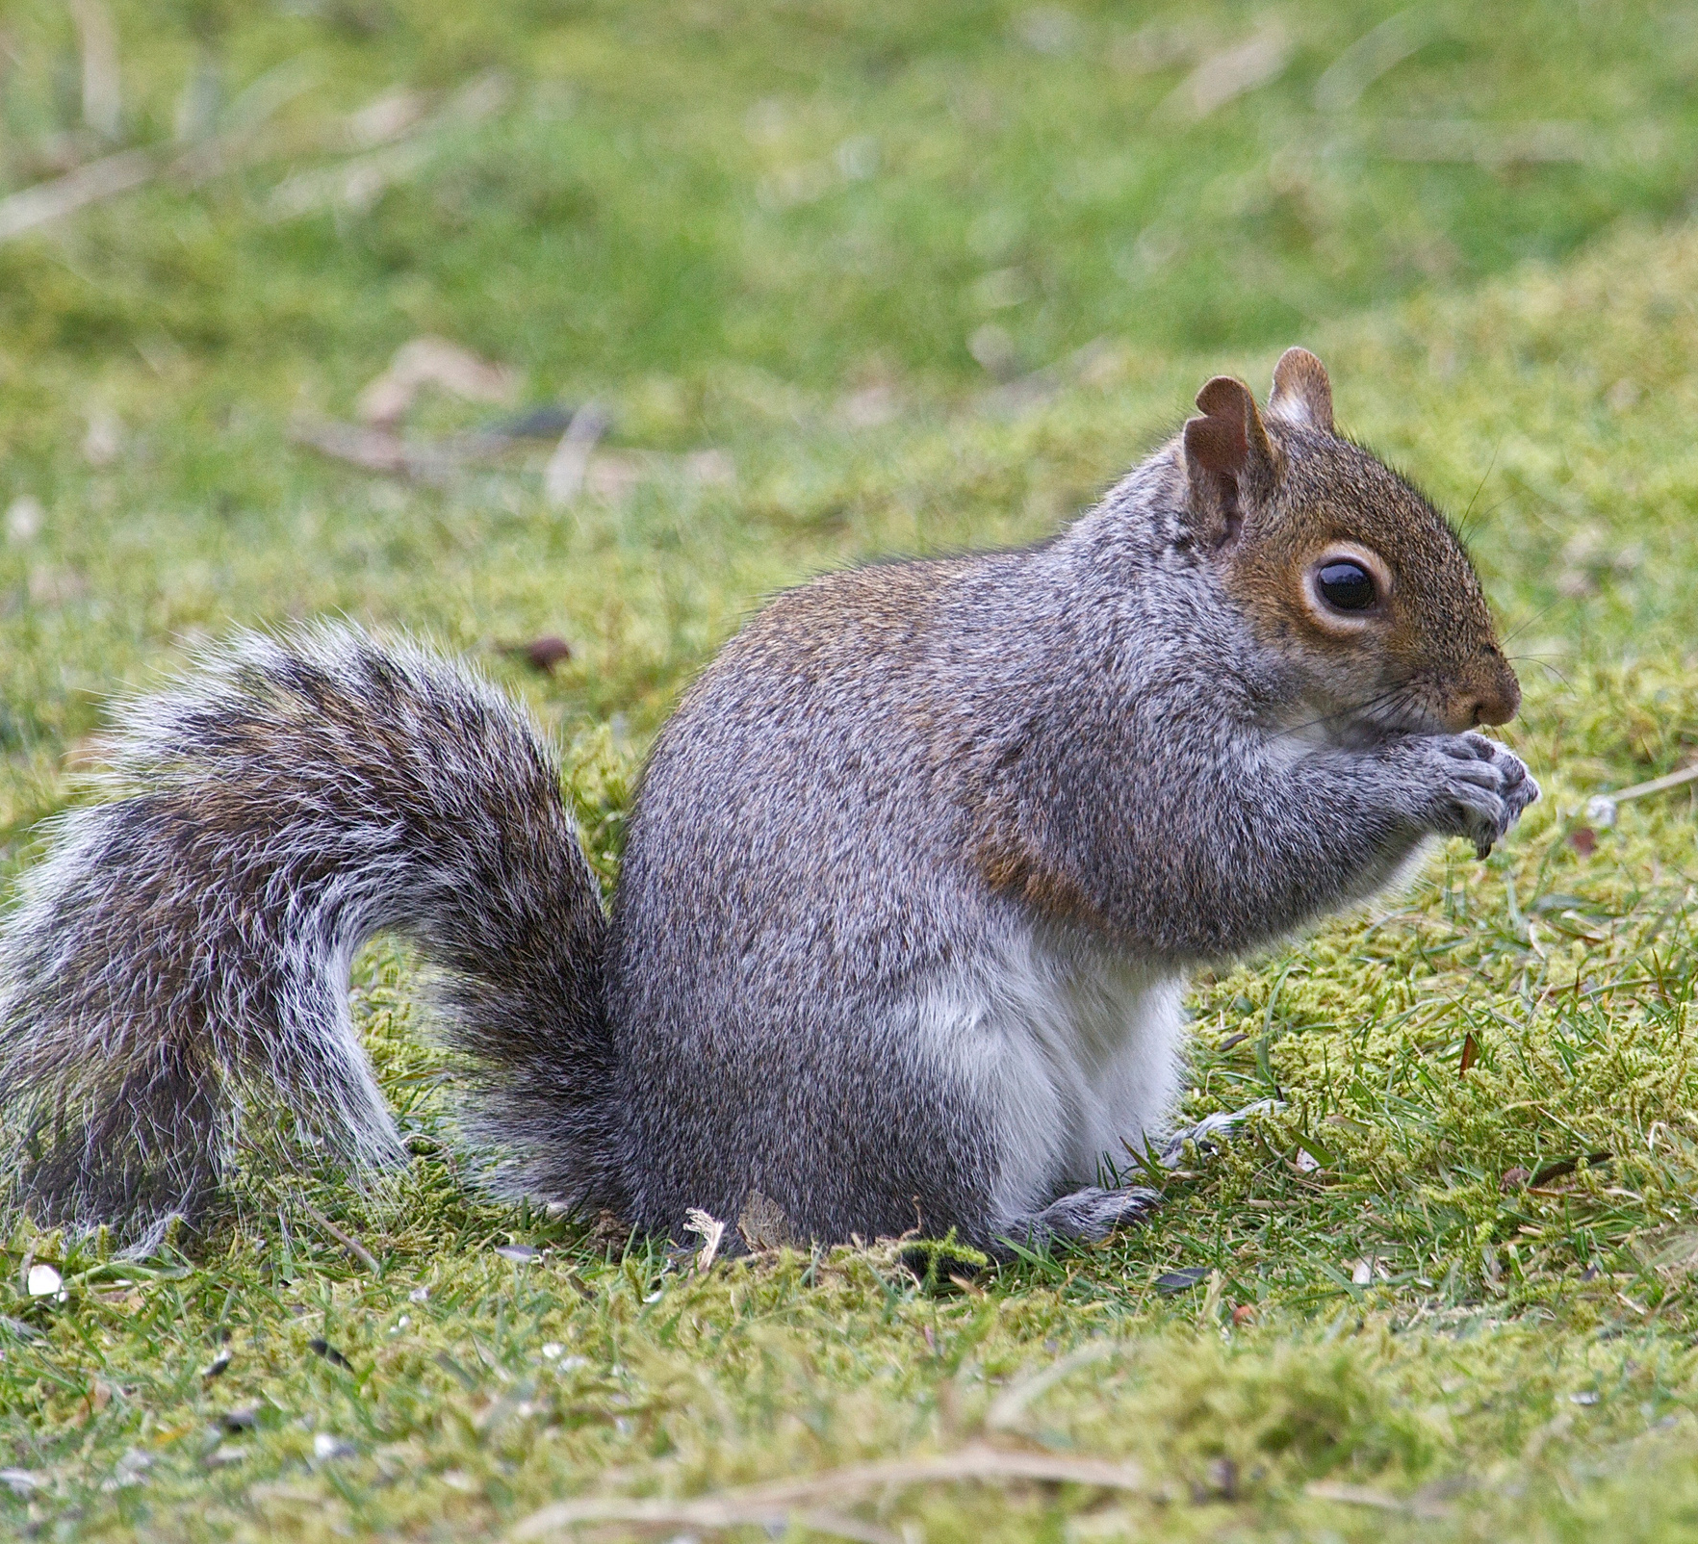
Grey Squirrel
Iora Glas
Sciurus carolinensis
The Grey Squirrel was introduced in 1911, from North America. It is bigger than the Red Squirrel and can take over in a woodland.

Slide 17
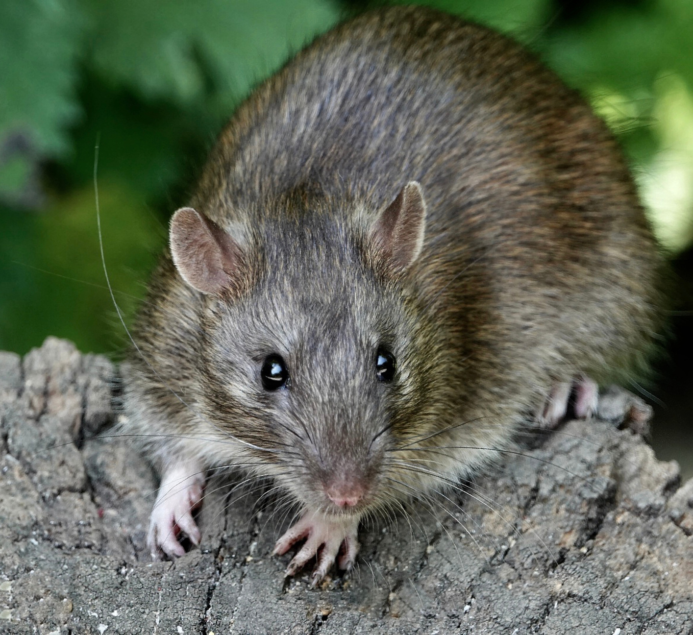
Brown Rat
Francach Donn
Rattus norvegicus
Rats are large rodents. they are found wherever people live.
Unfortunately, rats carry disease, and can damage houses.
Rats are an important food for owls, buzzards, foxes and other hunters.

Slide 18
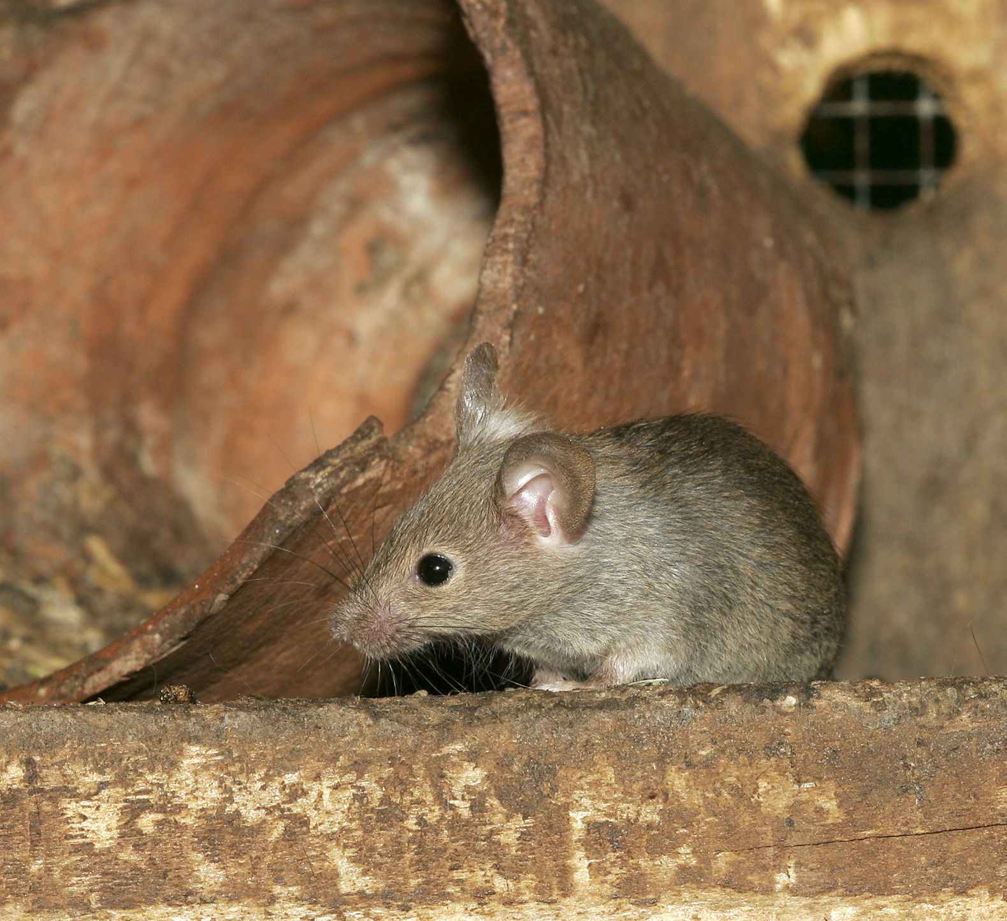
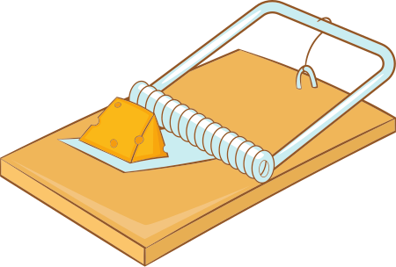
House Mouse
Luch Thí
Mus musculus domesticus
Like rats, House Mice live where people live and can damage houses.
Many larger animals eat mice.

Slide 19
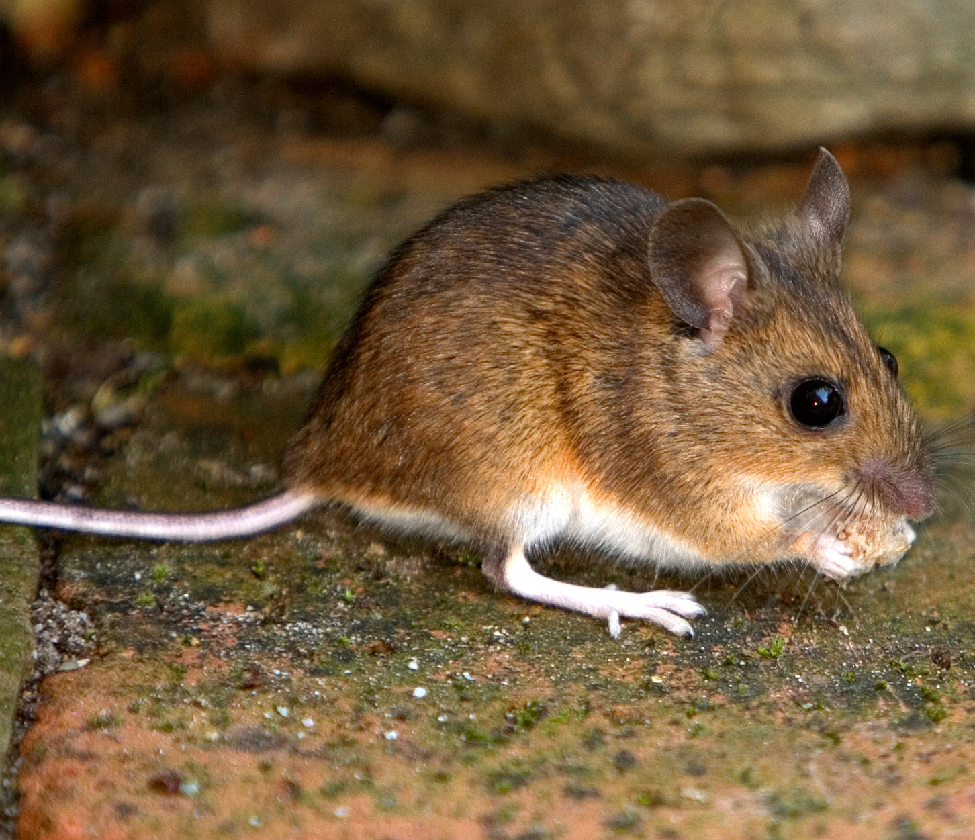
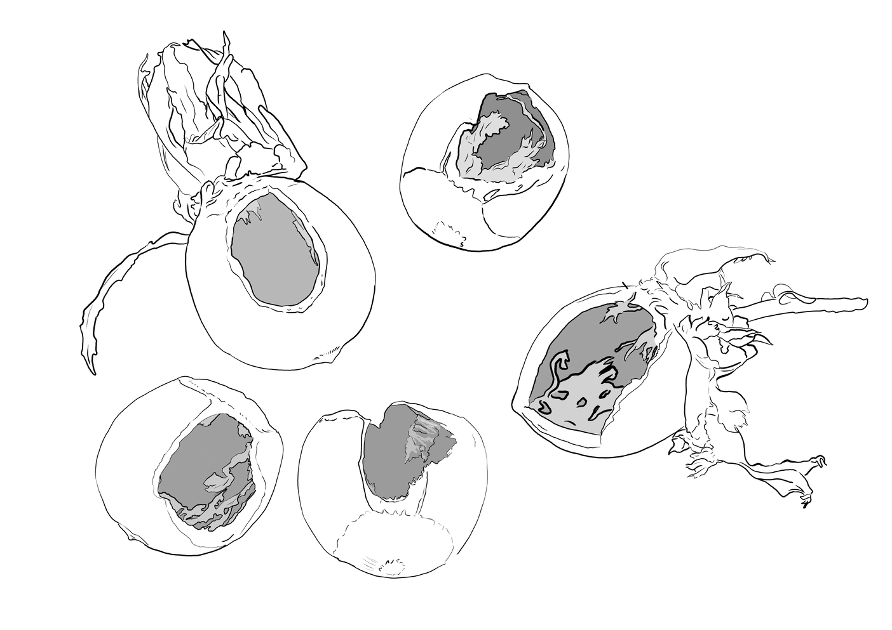
Wood Mouse
Luch Fhéir
Apodemus sylvaticus
Woodmice are handsome rodents. Unlike House Mice, they rarely come into houses. They prefer to live in the woods and fields, where they cause no harm.

Slide 20
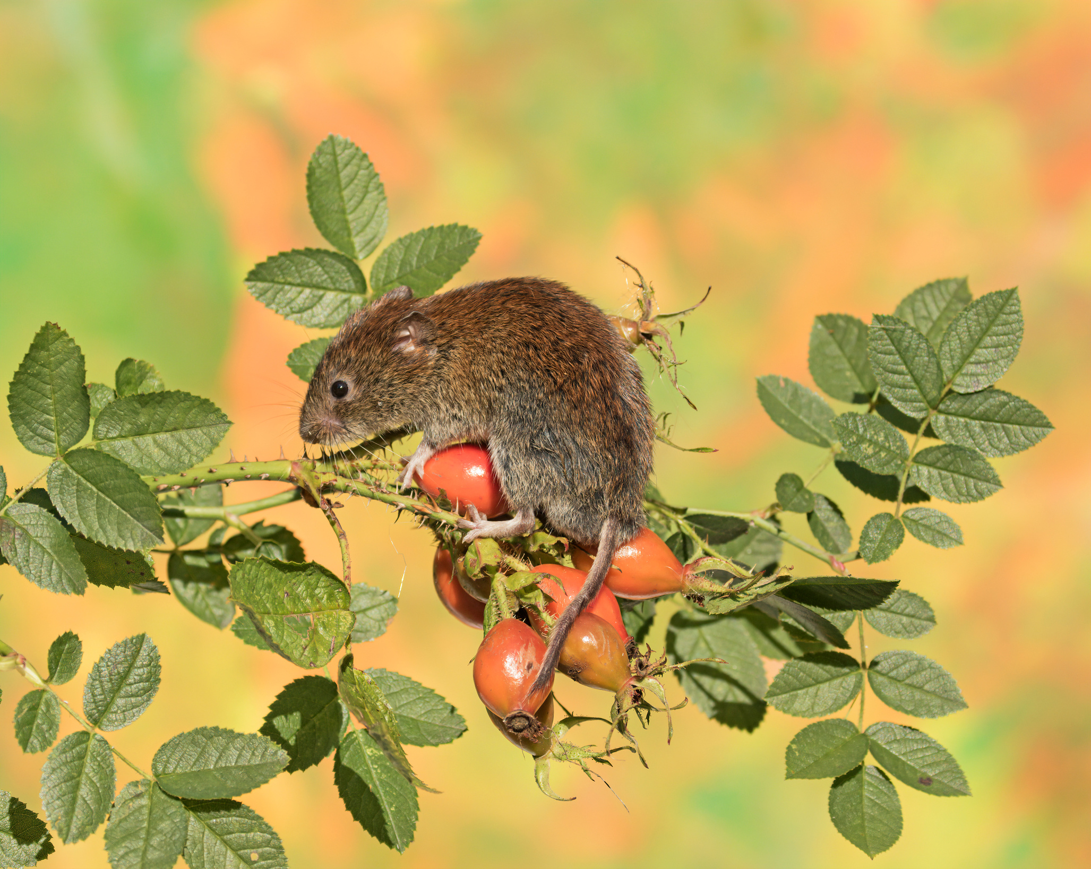
Bank Vole
Vol Bruaigh
Clethrionomys glareolus
Bank voles possibly arrived in Ireland in the 1920s. However, they were first discovered here, in Kerry, in 1964. Since then they have spread far and wide.
They look like tubby mice with a short tail.

Slide 21
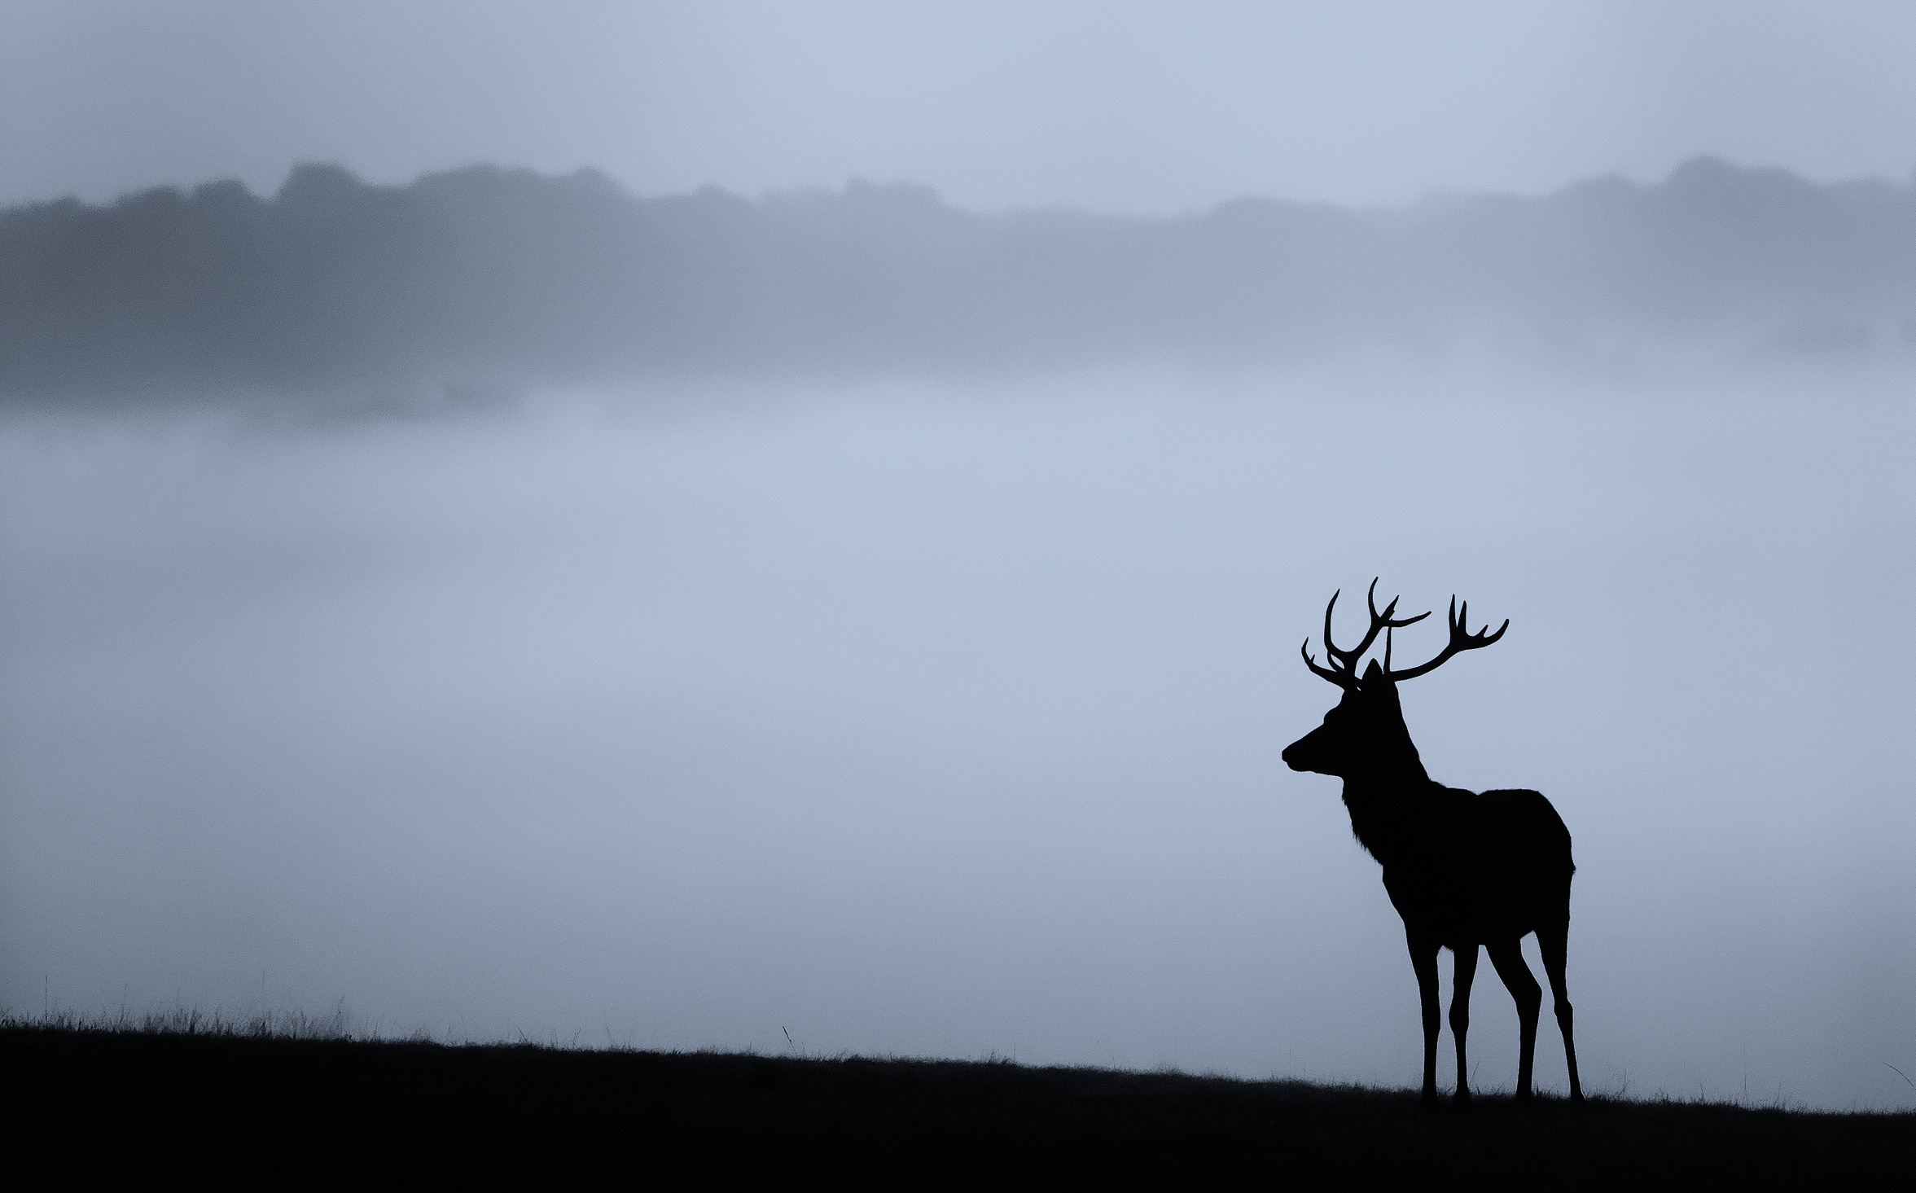
Thank You

