Slide 1
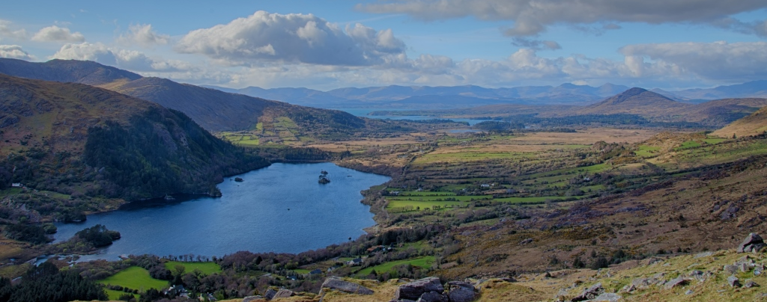
A National Biodiversity Expenditure Review for Ireland
Copyright @Kavanagh Photography
Copyright KAVANAGH PHOTOGRAPHY
Tracking and Analysing Domestic Spending on Biodiversity Conservation

Slide 2
Project objectives
A National Biodiversity Expenditure Review for Ireland
To identify current biodiversity-related expenditure and relevant policies
For reporting to Convention on Biological Diversity
To identify synergies and how expenditure could be more effective
Identify positive and negative impact of current policies, including perverse incentives
Future spending
Identify new opportunities to mobilise more resources
Improve design of existing policies.
Identify potential of other instruments, e.g. regulation, PES, biod offsets, etc.

Slide 3
Methods
A National Biodiversity Expenditure Review for Ireland
Literature review
Data collection
Identify status of existing procedures, e.g. CSO, Irish Aid
Identify expenditure by government departments and agencies
Identify expenditure by non-government bodies, including private sector and NGOs
Agree methodology to apportion expenditure to biodiversity
Evaluate future options
Revisit literature, review data and consultation

Slide 4
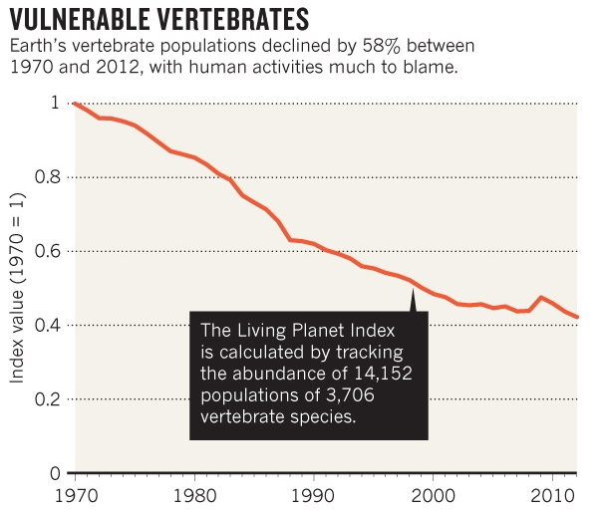
Global Biodiversity Loss
Ceballos et al. (2015)
Living Planning Index (2016)

Slide 5
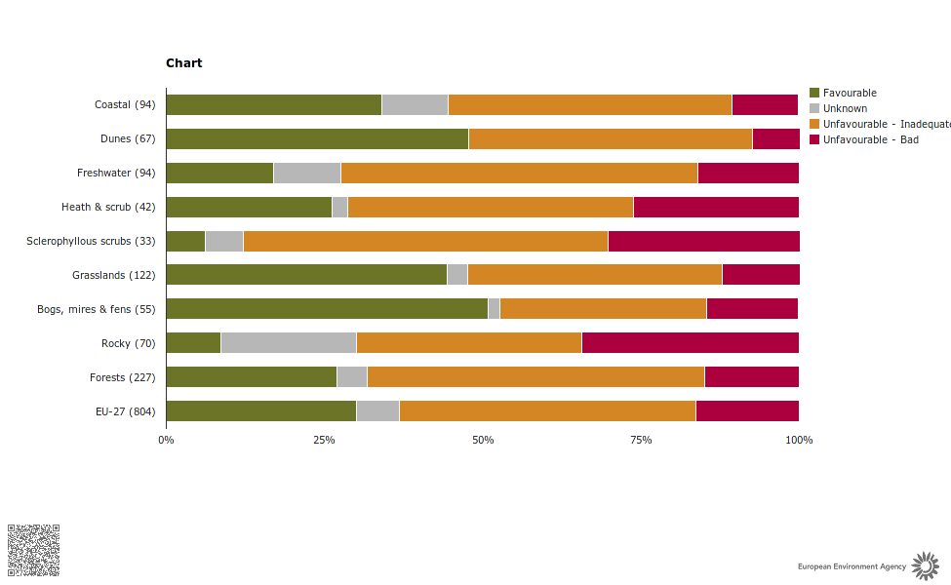
Biodiversity Decline in Europe and Ireland
Conservation status of habitats of European interest
Status and Trends in Habitats Protected Under the EU Habitats Directive in Ireland 2007-2013
European Environment Agency. (2015)
NPWS. (2014)

Slide 6
The Conservation Funding Gap
Current estimates place global conservation finance at:
Finance needed to achieve CBD Aichi targets is estimated to be
$50bn US dollars per year
$130-440bn US dollars per year
CBD 2010 Resource Mobilisation Strategy:
“to double financial flows to developing countries and to mobilise domestic financial resources from all sources to reduce the gap between identified needs and available resources at domestic level”.

Slide 7
Why Financial Reporting?
Define the funding gap
What are we spending?
Who are the main sources?
Who are the main recipients?
What sort of activities are funded?
Effectiveness of funding
Improve coherence and coordination
Fosters dialogue and discussion
Accountability and progress
Identify opportunities for resource mobilisation
BIOFIN. (2016)

Slide 8
(BIOFIN Workbook, 2016)

Slide 9
Biodiversity Expenditure Reviews
“A systematic review and critical analysis of the amount of biodiversity-related expenditures by key finance actors within a country in order to align expenditures with national goals, and to develop a baseline for past and future biodiversity finance” (BIOFIN; 2015).
Domestic Resource Availability
Government and Public Budgets
Private Sectors and Markets
Other/Non-profit
(NGOs, Foundations, academia)
National
Regional
Local

Slide 10
Undertaking a Biodiversity Expenditure Review
Programme based approach vs. agency based approach
Defining the scope of biodiversity related activities
Assigning coefficients: methods for attributing the percentage of financial resources to activities that are not 100% attributable to biodiversity
Capturing and attributing regional and local government expenditures
Capturing non-Government financial flows (businesses, NGOs and quasi-govt organisations)

Slide 11
Programmes and activities linked to biodiversity often target multiple environmental objectives…
“Of the total biodiversity-related development co-operation activities, the majority (63%, USD 3.5 billion) targets biodiversity as a significant objective, while 37% (USD 2.1 billion) targets biodiversity as the principal objective”
“Over 80% of biodiversity-related ODA in 2007-13 was in the sectors of general environment protection, agriculture, forestry, fishing, rural development, and water supply and sanitation”
(CBD Mexico, 2015).

Slide 12
Rio Markers: What to include and to what extent?
Principal Objective (100% Coefficient) (Rio Marker 2)
Significant Objective (Indirect) (80-1% Coefficient) (Rio Marker 1)
Policies and programmes where biodiversity objectives are fundamental to the activity and which are an explicit objective of the activity. They may be selected by answering the question “would the activity have been undertaken without this objective?”
Actions indirectly related to biodiversity but for which biodiversity conservation and sustainable use is not the main focus. This category includes initiatives across a range of sectors that benefit biodiversity but which have other primary purposes
Examples: Establishment and management of protected areas, support to environmental ngos, preparation of national biodiversity plans.
Examples: urban green infrastructure, agro-ecology, sustainable forest management, water treatment and management
*NB The qualification of a programme or project under the Rio Marker methodology does not imply evidence of the eventual delivery of biodiversity benefits.

Slide 13
Activity Type (France) | Examples | Proportion of total financing
Projects Rio Biodiversity Marker 2 | Protected Areas Support to Environmental NGOs | 100%
Projects Rio Biodiversity Marker 1 | Sustainable Forest Management Sustainable Fisheries Management | 80%
Projects Rio Biodiversity Marker 1 | Agro-ecology Pastoralism and nomadic livelihoods Organic and Fair Trade Supply Chains Sustainable watershed management | 30%
Projects Rio Biodiversity Marker 1 | Urban biodiversity development Responsible waste treatment | 5%
Communication | Activities with a biodiversity component | 50%
Knowledge generation | Studies dedicated to biodiversity | 100%
Estimated Relevance For The CBD Objectives (SWISS –BD Factor) | Biodiversity factor
 | Value (0-1) | %
Budgetary Item Supports CBD’s Objectives To Its Full Extent | 1.00 | 100%
Budgetary Item Supports CBD’s Objectives Significantly | 0.75 | 75%
About Half of the Budgetary Item Supports CBD’s Objectives | 0.50 | 50%
Budgetary Item Contributes to CBD’s Objectives for the Smaller Part | 0.25 | 25%
A Minor Part of the Budgetary Item Contributes to CBD’s Objectives | 0.10 | 10%
A Marginal Part of the Budgetary Item Contributes to CBD’s Objectives | 0.05 | 5%

Slide 14
Progress so far:
Private Sectors and Markets
Other/Non-profit
(NGOs, Foundations, academia)
Government and Public Budgets
In contact
Contacted
Yet to contact
Yet to decide on a methodology
Contacted
NPWS
CSO
DAFM (Agri)
IRISH AID
DAFM (FORESTRY)
OPW
IFI
FAILTE IRELAND
DAFM (MARINE)
DoF
DHPC
DoI
DAHRRGA
EPA
etc..
Surveys
Interviews
CSR report reviews
NGOs included under the Environment Pillar
Reviewing annual reports

Slide 15
Questions:
We are collecting expenditure data from 2010-2015 .
Do you know of schemes or programmes that should be included from your own department or others?
Would you be willing to participate or know of anyone who would be useful to contact?
Do you have any methodological concerns/advice?

Slide 16
Thank you for your time.
rachel.morrison@ucd.ie
craig.bullock@ucd.ie

Slide 17
References:
BIOFIN, 2016. BIOFIN Workbook, United Nations Development Programme, New York.
Ceballos, G. et al., 2015. Accelerated modern human–induced species losses: Entering the sixth mass extinction. Science Advances, 1(5).
WWF. 2016. Living Planet Report 2016. Risk and resilience in a new era. WWF International, Gland, Switzerland.
European Environment Agency, 2015. The European Environment State and Outlook 2015: Executive Summary,. EEA, Copenhagen.
NPWS (National Parks and Wildlife Service) 2014. Irelands 5th national report to the convention on biological diversity, Department of Arts, Heritage and the Gaeltacht, Dublin.

